Slide 1

Module 1 Lecture
Dr. Steward Huang

Slide 2
Chapter 9: "The Business Requirements"
Key Points:
Importance of Business Requirements
Understanding the role of business requirements in data modeling
Impact of accurate business requirements on the success of data modeling projects
Gathering Business Requirements
Techniques for gathering business requirements (interviews, questionnaires, use case modeling)
Involving stakeholders and subject matter experts in the requirements gathering process
Analyzing Business Requirements
Analyzing and prioritizing business requirements
Identifying dependencies, constraints, and potential conflicts in the requirements
Documentation and Validation
Documenting business requirements using appropriate notations and tools
Validating business requirements with stakeholders to ensure accuracy and completeness
Iterative Nature of Business Requirements
Recognizing that business requirements can evolve and change over time
Incorporating flexibility and adaptability in the data modeling process

Slide 3
Chapter 9: "The Business Requirements"
Summary: Chapter 9 focuses on the crucial role of business requirements in data modeling. It explains the process of gathering, analyzing, documenting, and validating business requirements. It emphasizes the importance of stakeholder involvement and highlights the iterative nature of business requirements.

Slide 4
Chapter 10: "Conceptual Data Modeling"
Key Points:
Introduction to Conceptual Data Modeling
Definition and purpose of conceptual data modeling
Overview of Entity-Relationship (ER) diagrams as a popular conceptual modeling technique
https://www.edrawsoft.com/er-diagram-examples.html
Entities, Attributes, and Relationships
Identifying and defining entities and their attributes
Establishing relationships and cardinality constraints between entities
Conceptual Model Diagramming
Guidelines for creating clear and understandable conceptual data models
Using appropriate notations and symbols in ER diagrams
Data Model Abstraction
Abstracting data models to focus on essential business concepts
Avoiding unnecessary implementation details in conceptual data models
Conceptual Model Refinement
Refining and improving conceptual data models based on feedback and iterative refinement
Ensuring alignment with business requirements and user expectations

Slide 5
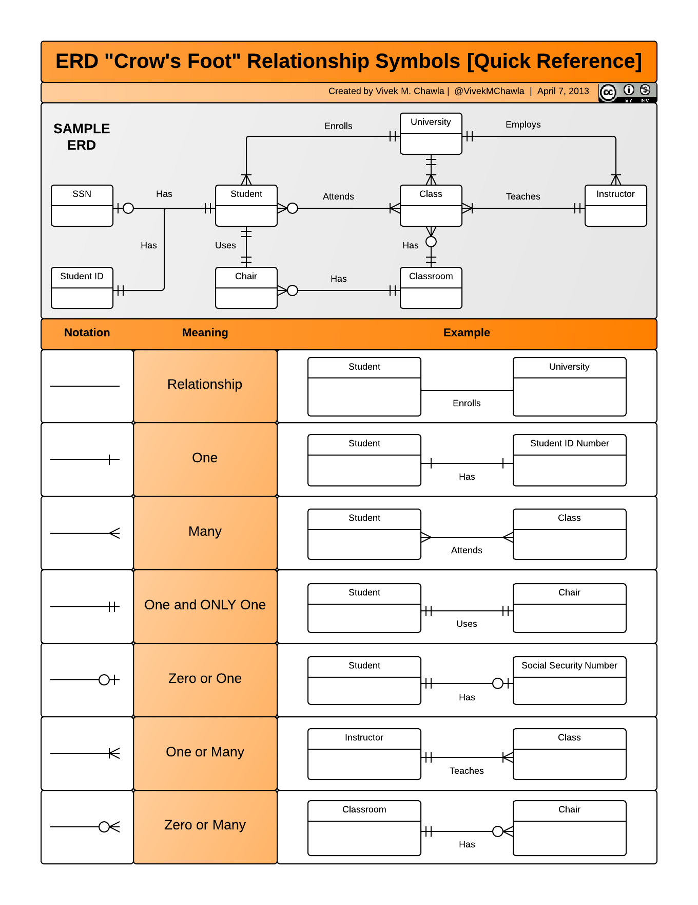
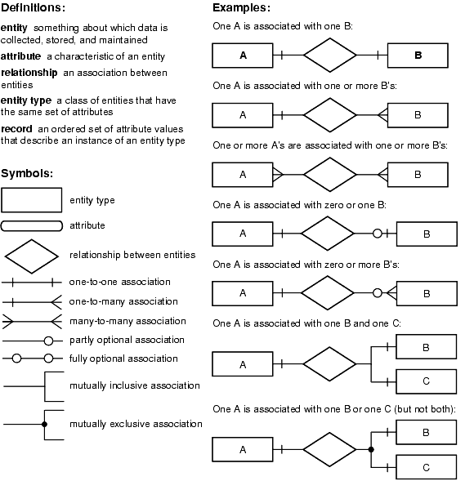
ERD Relationship Quick Reference

Slide 6
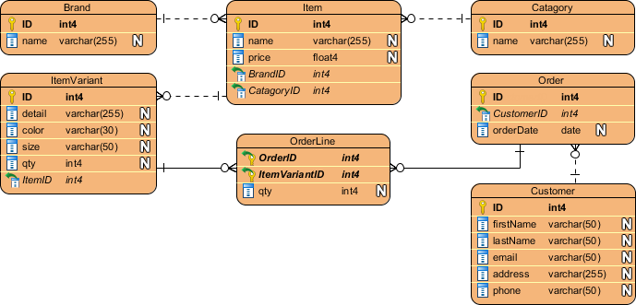
A Sample of ERD (not perfect, just fyi)
How to Generate Redshift Database from ERD?
You can design database with Entity Relationship Diagram (ERD), and then
generate a physical database from the design.
In this tutorial, you will draw a simple ERD for an online bike shop,
enter sample data for your database and then
generate an Amazon Redshift database.
https://www.visual-paradigm.com/tutorials/erd-to-redshift.jsp

Slide 7
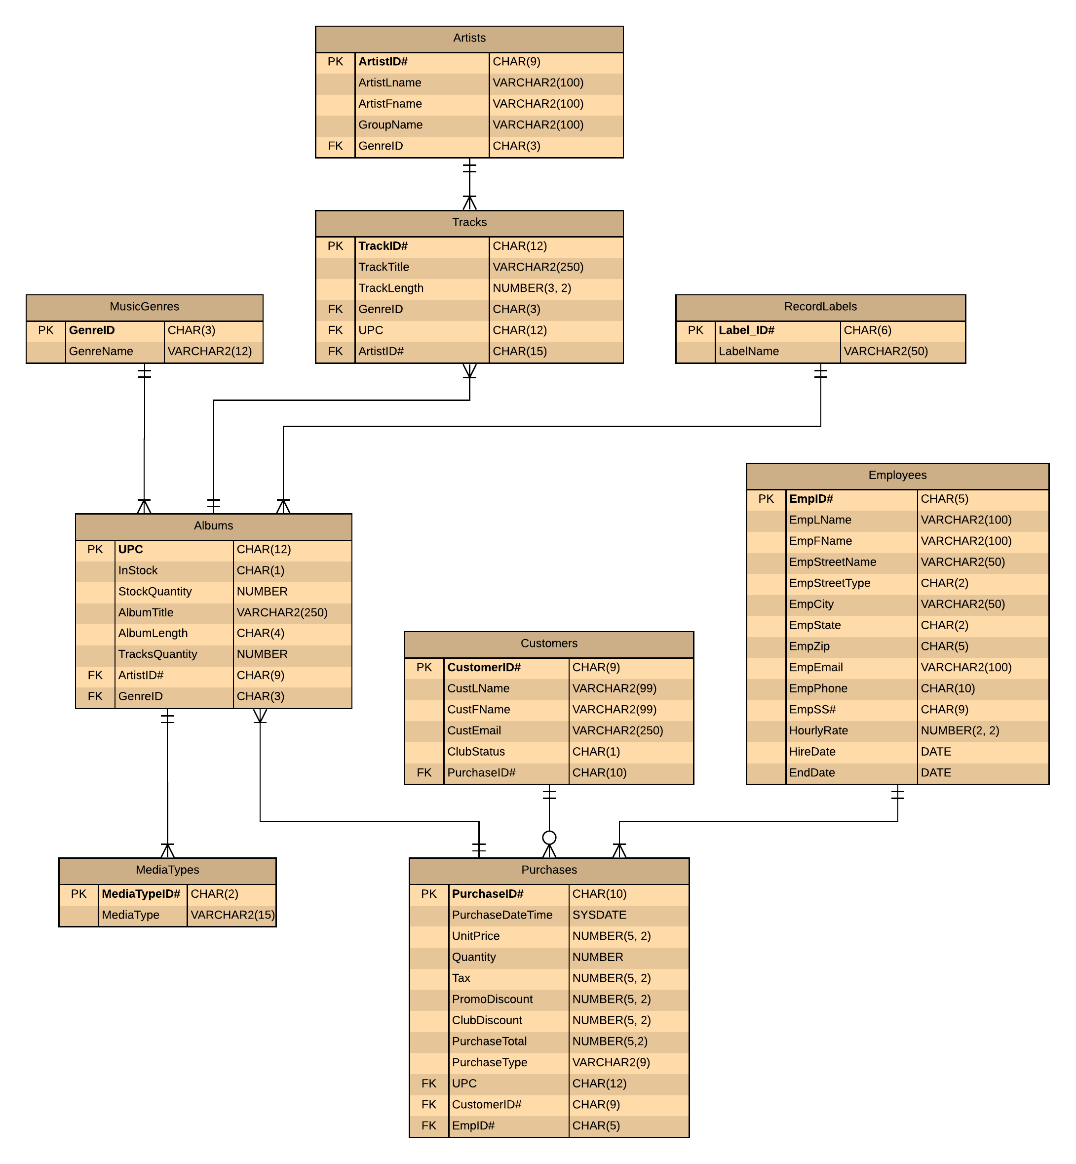
Another Sample f ERD (not perfect, just fyi, can you find some errors in it?)

Slide 8
Chapter 10: "Conceptual Data Modeling"
Summary: Chapter 10 introduces conceptual data modeling as a crucial step in the data modeling process. It explains the key components of conceptual models, including entities, attributes, and relationships. It emphasizes the importance of clear and concise diagramming and highlights the iterative nature of conceptual model refinement.

Slide 9
Chapter 11: "Logical Database Design"
Key Points:
Transition from Conceptual to Logical Models
Understanding the relationship between conceptual and logical data models
Converting conceptual models into normalized logical data models
Normalization and Normal Forms
Introduction to normalization and its benefits
Explaining the concept of normal forms (1NF, 2NF, 3NF, BCNF)
https://www.splunk.com/en_us/blog/learn/data-normalization.html
Entity Relationship Diagrams (ERDs)
Mapping conceptual models to logical models using ERDs
Identifying primary keys, foreign keys, and cardinality constraints in logical data models
https://techdocs.broadcom.com/us/en/ca-mainframe-software/database-management/ca-idms/19-0/administrating/database-design/introduction-to-logical-design.html
Normalization Techniques
Applying normalization techniques to eliminate data redundancy and improve data integrity
Demonstrating the process of normalizing tables and resolving functional dependencies
Iterative Refinement and Validation
Iteratively refining and validating logical data models
Ensuring the logical model aligns with business requirements and can support required operations and queries

Slide 10
Chapter 11: "Logical Database Design"
Summary: Chapter 11 focuses on logical database design, which involves converting conceptual models into normalized logical data models. It explains the importance of normalization and introduces various normal forms. It also emphasizes the use of ERDs in mapping conceptual models to logical models and highlights the iterative

Slide 11
Chapter 12: "Physical Database Design"
Key Points:
Introduction to Physical Database Design
Understanding the purpose and goals of physical database design
Differentiating physical design from logical design
Performance Considerations
Considering performance factors in physical database design (e.g., query optimization, indexing, partitioning)
Optimizing database design for efficient data retrieval and manipulation
Data Storage and Organization
Selecting appropriate data storage structures (e.g., tables, indexes, views)
Organizing data effectively for storage and retrieval efficiency
Security and Integrity
Incorporating security measures into the physical design (e.g., access controls, encryption)
Ensuring data integrity through constraints, triggers, and validation rules
Scalability and Maintenance
Designing for scalability to handle increasing data volumes and user loads
Considering maintenance aspects, such as backup and recovery, data archiving, and system monitoring

Slide 12
Chapter 12: "Physical Database Design"
Summary: Chapter 12 delves into the process of physical database design, which focuses on translating the logical data model into an actual physical database implementation. It highlights the importance of performance optimization, data storage and organization, security and integrity measures, as well as scalability and maintenance considerations.

Slide 13
Chapter 13: "Advanced Normalization"
Key Points:
Overview of Advanced Normalization Forms
Introducing advanced normalization forms beyond 3NF (e.g., 4NF, 5NF)
Understanding the benefits and use cases for advanced normalization
Fourth Normal Form (4NF)
Exploring the concept of multivalued dependencies and the need for 4NF
Demonstrating the process of achieving 4NF through decomposition and restructuring
Fifth Normal Form (5NF)
Understanding the concept of join dependencies and the need for 5NF
Applying the principles of 5NF to eliminate redundancies and improve data integrity
Advanced Normalization Challenges
Discussing challenges and considerations in achieving advanced normalization forms
Balancing normalization with performance, complexity, and practicality
Evaluating Normalization Choices
Assessing the trade-offs between different normalization levels and their implications
Considering the specific requirements of the database system and the intended usage scenarios
Notes:
Advanced normalization refers to sophisticated techniques used in data preprocessing and transformation to improve the quality and usefulness of data in various applications, such as machine learning, data mining, and database management.
Normalization is the process of organizing data in a consistent and standardized manner, reducing redundancy and dependency, and ensuring data integrity. While basic normalization techniques like min-max scaling and z-score normalization are widely used, advanced normalization techniques offer more sophisticated ways to handle complex data distributions and address specific data challenges.
Here are some examples of advanced normalization techniques:
Robust Scaling: This technique is an extension of min-max scaling and z-score normalization. It is suitable for data with outliers and extreme values. Robust scaling uses the interquartile range (IQR) instead of the standard deviation to determine the scaling parameters, making it more resistant to outliers.
Log Transformation: Log transformation is used to handle data with a skewed distribution, particularly when the data spans several orders of magnitude. By taking the logarithm of the values, the data can be compressed and brought closer to a normal distribution.
Power Transformation: Power transformation, such as the Box-Cox transformation, is employed to stabilize the variance of data and make it conform more closely to a normal distribution. It applies a mathematical function to the data, typically a power law, to achieve the transformation.
Quantile Transformation: Quantile transformation maps the original data distribution to a standard normal distribution. It can be particularly useful when the data exhibits nonlinear relationships or heavy-tailed distributions. The transformed data has equal quantiles, making it useful in certain statistical techniques and machine learning algorithms.
Discretization: Discretization involves transforming continuous variables into discrete categories or intervals. It can be helpful when dealing with continuous data that doesn't follow a normal distribution or when categorical variables need to be created from continuous data for specific analysis purposes.
These are just a few examples of advanced normalization techniques. The choice of technique depends on the nature of the data, its distribution, and the specific requirements of the application or analysis at hand.

Slide 14
Chapter 13: "Advanced Normalization"
Summary: Chapter 13 delves into advanced normalization techniques beyond the traditional 3NF. It introduces 4NF and 5NF, explaining their significance and providing examples of achieving these higher normal forms. It also discusses the challenges and considerations involved in advanced normalization and emphasizes the importance of evaluating normalization choices based on the specific database system and usage requirements.

Slide 15
Predictive analysis, prescriptive analysis, and descriptive analysis
Predictive analysis, prescriptive analysis, and descriptive analysis are three distinct types of data analysis techniques that serve different purposes. Here's a comparison of these three approaches:
Descriptive Analysis: Descriptive analysis focuses on summarizing and visualizing historical data to gain insights into past events and understand what has happened. It involves organizing and presenting data in a meaningful way, such as through tables, charts, and graphs. Descriptive analysis answers questions like "What happened?" and "What are the key trends and patterns in the data?" It provides a retrospective view and helps in understanding the current state of affairs.
Example: Generating a report that shows sales figures by region and product category for the past year.
Predictive Analysis: Predictive analysis involves analyzing historical data and applying statistical and machine learning techniques to make predictions or forecasts about future events or outcomes. It uses patterns and relationships identified in the data to estimate likely future scenarios. Predictive analysis answers questions like "What is likely to happen?" and "What are the potential future outcomes?" It helps in decision-making by providing insights into future trends and allowing proactive actions.
Example: Using historical sales data, market trends, and customer demographics to predict future demand for a product and optimize inventory levels.
Prescriptive Analysis: Prescriptive analysis goes beyond descriptive and predictive analysis by providing recommendations or actions to optimize decision-making. It uses advanced analytics techniques, optimization algorithms, and simulations to determine the best course of action based on specific goals, constraints, and available resources. Prescriptive analysis answers questions like "What should be done?" and "What actions should be taken to achieve a desired outcome?" It provides actionable insights and helps in identifying the best strategies for achieving desired outcomes.
Example: Optimizing production scheduling and resource allocation to maximize efficiency and minimize costs while meeting customer demand.
In summary, descriptive analysis focuses on historical data and describes what has happened, predictive analysis uses historical data to make predictions about the future, and prescriptive analysis recommends optimal actions to achieve desired outcomes. These three types of analysis are complementary and often used together to gain a comprehensive understanding of data, make informed decisions, and drive business success.

Slide 16
Modern Tools for Predictive Analysis
Here are some modern tools commonly used for predictive analysis:
Python: Python is a popular programming language for data analysis and has several libraries that are widely used for predictive analytics, such as scikit-learn, TensorFlow, and Keras.
R: R is another widely used programming language for statistical analysis and predictive modeling. It has a vast collection of packages specifically designed for data analysis and machine learning, such as caret, randomForest, and xgboost.
Apache Spark: Apache Spark is an open-source distributed computing system that provides a unified analytics engine for big data processing. It has libraries like MLlib, which offer a rich set of machine learning algorithms for predictive analytics at scale.
Tableau: Tableau is a powerful data visualization tool that also offers built-in predictive analytics capabilities. It allows users to explore data, build interactive visualizations, and create predictive models using a drag-and-drop interface.
RapidMiner: RapidMiner is an integrated data science platform that offers a wide range of tools for predictive analytics. It provides a visual workflow designer, supports various machine learning algorithms, and enables users to deploy predictive models in production.
Microsoft Azure Machine Learning: Azure Machine Learning is a cloud-based platform provided by Microsoft for building, training, and deploying machine learning models. It offers a drag-and-drop interface, supports Python and R, and provides integration with other Azure services.
IBM Watson Studio: Watson Studio is an IBM cloud-based platform that allows users to collaboratively build and deploy predictive models. It provides a variety of tools for data preparation, feature engineering, model training, and model deployment.
Google Cloud AutoML: Google Cloud AutoML is a suite of machine learning products offered by Google Cloud Platform. It provides automated tools to build custom machine learning models for various tasks, including image recognition, natural language processing, and tabular data analysis.
H2O.ai: H2O.ai is an open-source machine learning platform that offers scalable and distributed algorithms for predictive analytics. It provides an easy-to-use interface and supports integration with popular programming languages like Python and R.
DataRobot: DataRobot is an automated machine learning platform that helps users build accurate predictive models with minimal manual effort. It offers a user-friendly interface and automates various steps in the predictive modeling process, from data preparation to model selection and deployment.
These tools provide a range of capabilities for predictive analysis, and the choice depends on the specific requirements of your project, the size of your data, and your familiarity with the tools.

Slide 17
Examples of predictive analysis applications across various industries
Here are some examples of predictive analysis applications across various industries:
Retail:
Demand Forecasting: Predicting future demand for products based on historical sales data, seasonality, promotions, and external factors like weather conditions.
Customer Churn Prediction: Identifying customers who are likely to churn or stop purchasing from the company, allowing targeted retention strategies.
Price Optimization: Analyzing customer behavior and market trends to determine optimal pricing strategies for maximizing revenue.
Healthcare:
Disease Outbreak Prediction: Using historical data and epidemiological models to forecast the spread of diseases and allocate healthcare resources accordingly.
Patient Readmission Prediction: Predicting the likelihood of a patient being readmitted to the hospital within a specific time frame, enabling proactive interventions and better care management.
Fraud Detection: Identifying fraudulent activities in healthcare claims, such as billing fraud and insurance abuse, by analyzing patterns and anomalies in the data.
Financial Services:
Credit Scoring: Assessing the creditworthiness of individuals or businesses to determine the risk of default and make informed lending decisions.
Fraud Prevention: Analyzing transactional data to identify suspicious patterns and detect fraudulent activities, such as credit card fraud and money laundering.
Stock Market Forecasting: Predicting stock price movements based on historical data, market trends, news sentiment, and other relevant factors.
Manufacturing:
Equipment Maintenance: Predicting equipment failures or breakdowns by analyzing sensor data and operational parameters, allowing for proactive maintenance and minimizing downtime.
Quality Control: Identifying potential defects or quality issues in the manufacturing process by analyzing sensor data, production metrics, and historical inspection data.
Supply Chain Optimization: Forecasting demand, optimizing inventory levels, and improving logistics by analyzing historical sales data, market trends, and external factors like weather and transportation.
Energy and Utilities:
Load Forecasting: Predicting future energy demand to optimize power generation and distribution, reduce costs, and ensure reliable energy supply.
Equipment Failure Prediction: Anticipating equipment failures in power plants or utility infrastructure by analyzing sensor data, maintenance records, and environmental factors.
Renewable Energy Output Prediction: Forecasting the output of renewable energy sources like solar and wind farms to optimize energy production and grid integration.
These examples highlight how predictive analysis can be applied across different industries to improve decision-making, optimize operations, and enhance customer experiences.

Slide 18
All required criteria:
Meets all criteria: ● Identifies the relationships ● Identifies the primary/foreign keys ● Identifies the relationships between the entities
Meets all criteria: ● Writes at least two pages of content ● Explains the steps (3 NF) to normalize the model ● Explains the relationships ● Provides six attributes or more for each entity
Meets all criteria: ● Indicates the keys, primary and foreign ● Indicates the relationships between the entities ● Indicates correct field data types ● Indicates correct field sizes ● Indicates correct nullability for the columns accordingly
Includes screenshot of an installed MS SQL Server in Appendix.
Creates SQL script to create a schema and creates a proper schema.
Establishes a Customer table with six or more proper attributes with correct sizes, data types, and nullability assigned.
Establishes a Products table with six or more proper attributes with correct sizes, data types, and nullability assigned.
Establishes an Orders table with 6 or more proper attributes with correct sizes, data types, and nullability assigned.
Establishes an Order Details table with proper attributes, correct attribute sizes, correct data types, and correct nullability assigned.
Meets all criteria: • Applies current APA style to in-text citations and references and document formatting if appropriate, with minor to no errors. • Writing is focused, concise, organized, and articulated at a college level, with minor to no errors. • Uses resources from reliable and/or scholarly sources.

